Slide 1
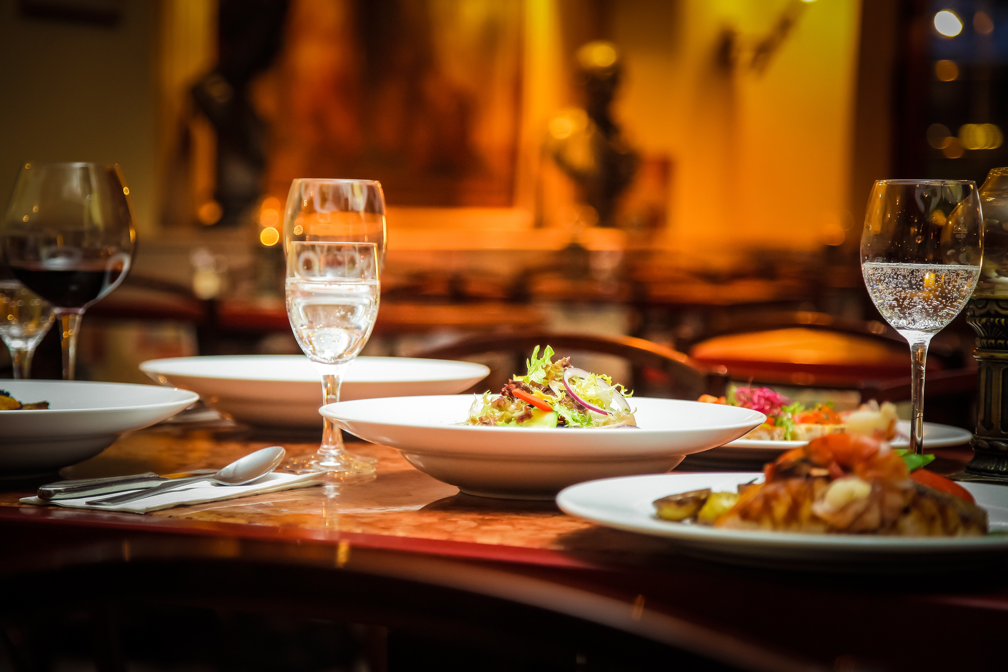
GROUP 8
COURSE:
EBS405
Võ Thiên Vũ
Nguyễn Thanh Duy
Huỳnh Hoàng Trung
Nguyễn Phan Hoài Nam
Nguyễn Huỳnh Kha

Slide 2




BIG BITE
RESTAURANT

Slide 3
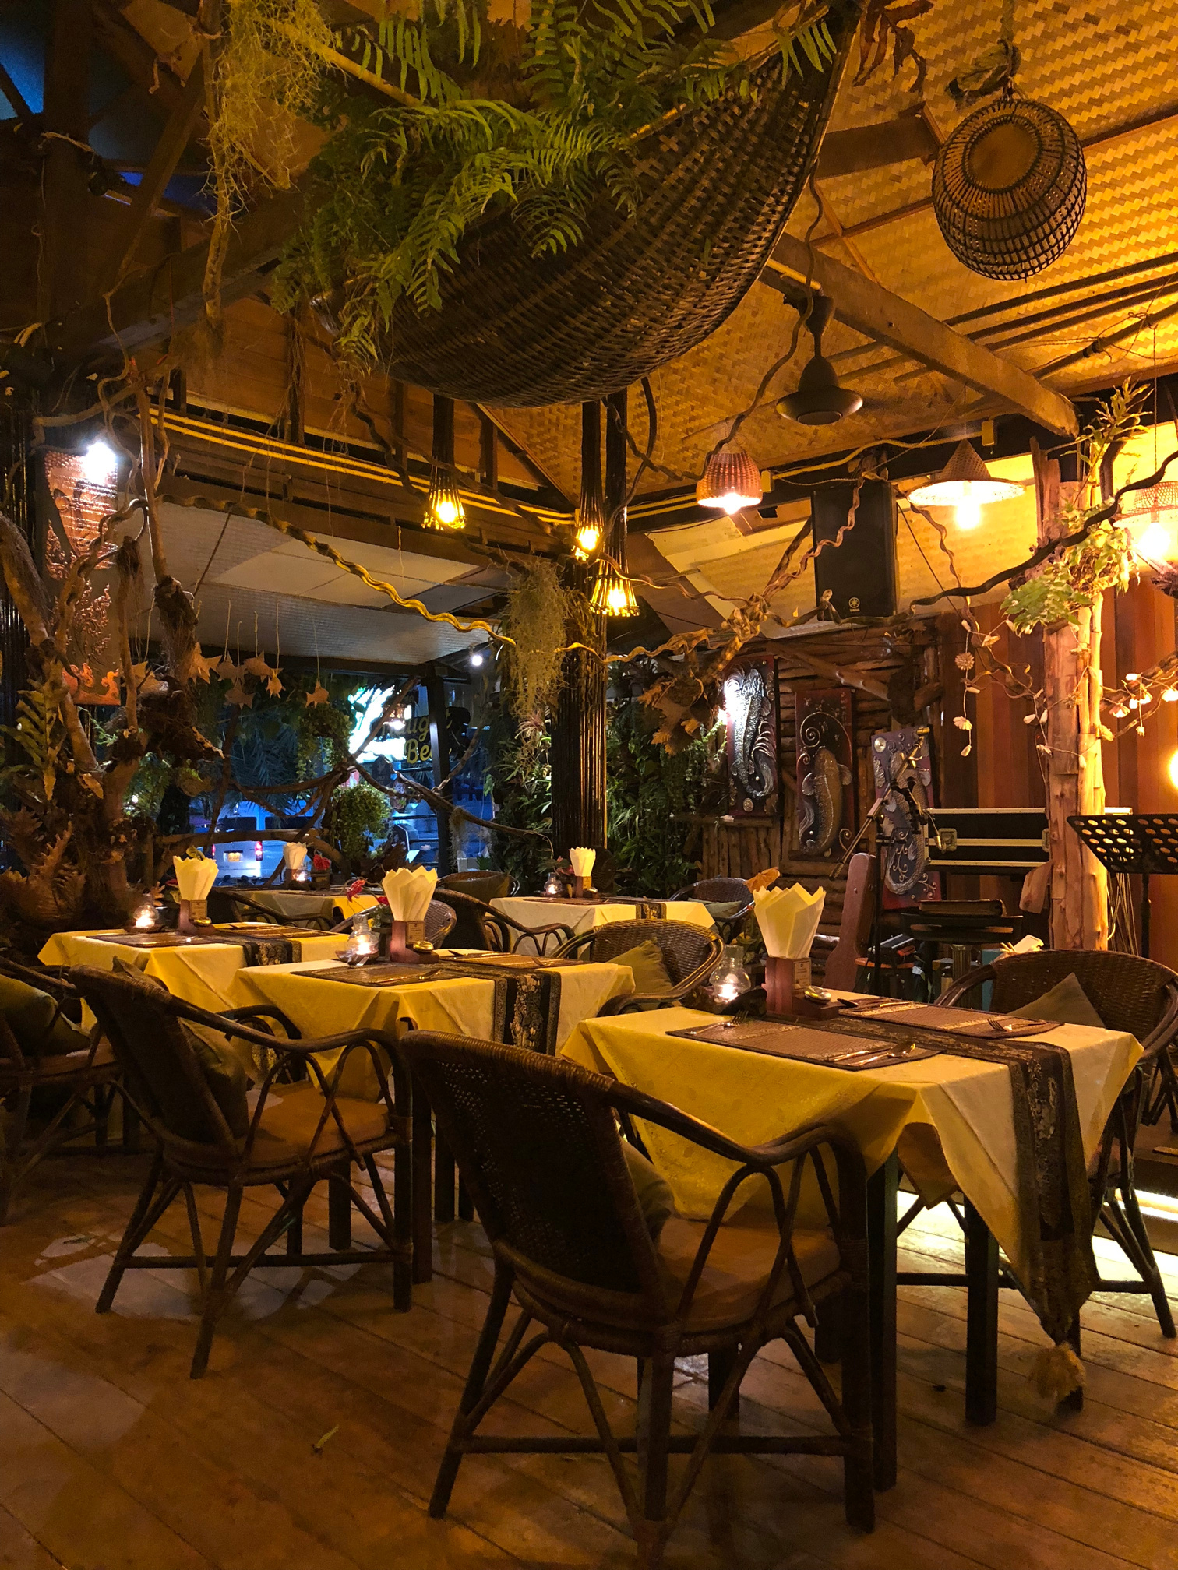

Executive Summary
Highlights
Strong financial performance with consistent sales growth and healthy profit margins.
Established a loyal customer base and achieved positive customer feedback.
Maintained efficient cost management and achieved profitability.
restaurant.co

Slide 4
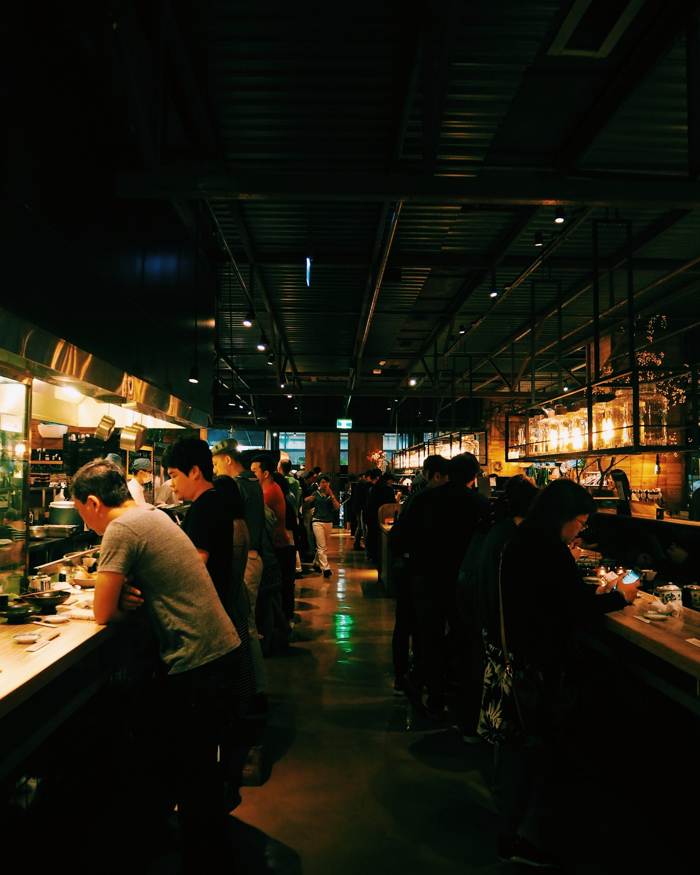
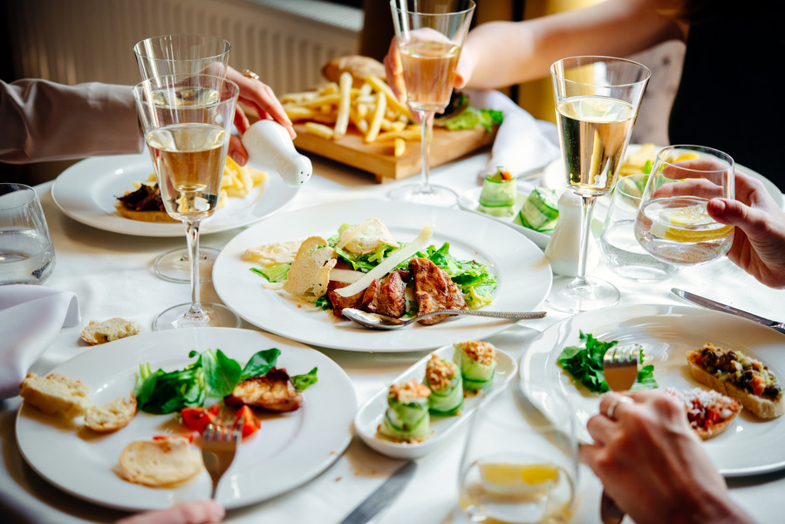
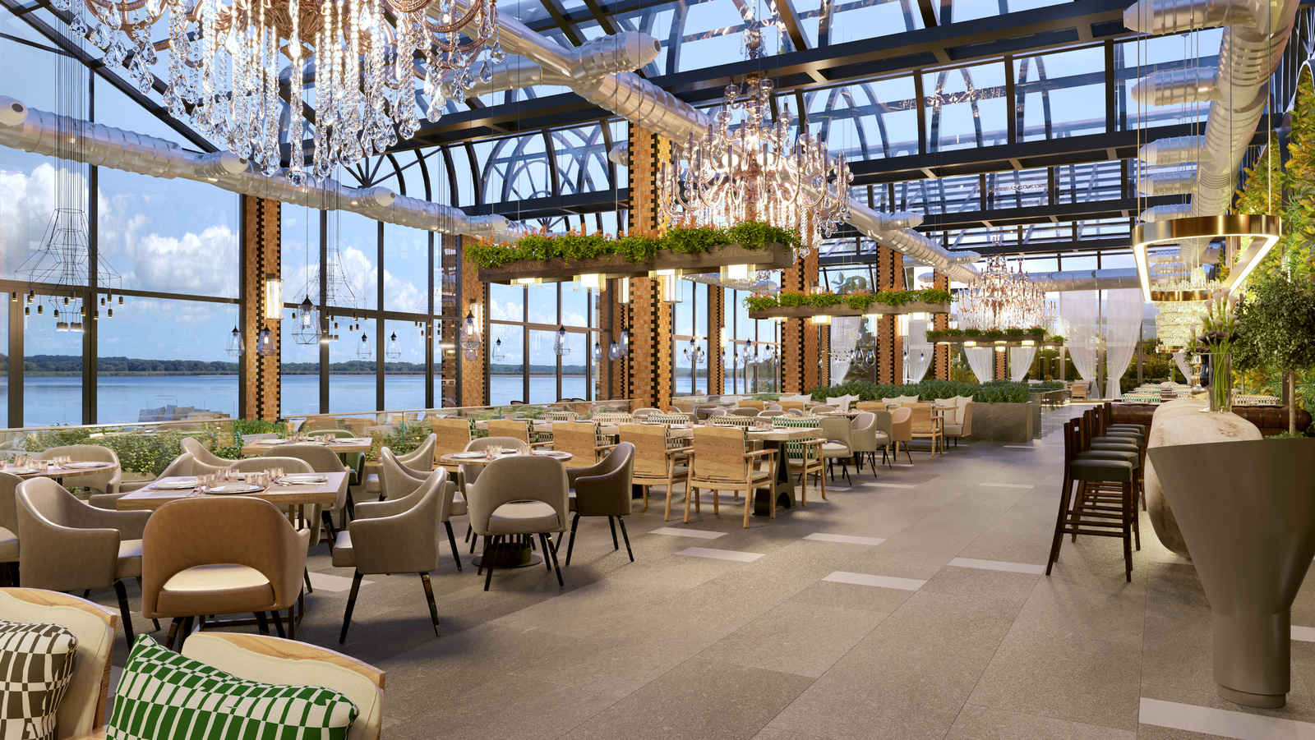

Great Taste
A restaurant is a place that people visit to look for various kinds of local food and drinks.
Objectives
Established Vietnamese-style restaurant known for its high-quality hot pot experience.
Expand the business to multiple locations within the region within the next five years.
Build a strong brand reputation and become a preferred choice for hot pot dining.
About Company

Slide 5
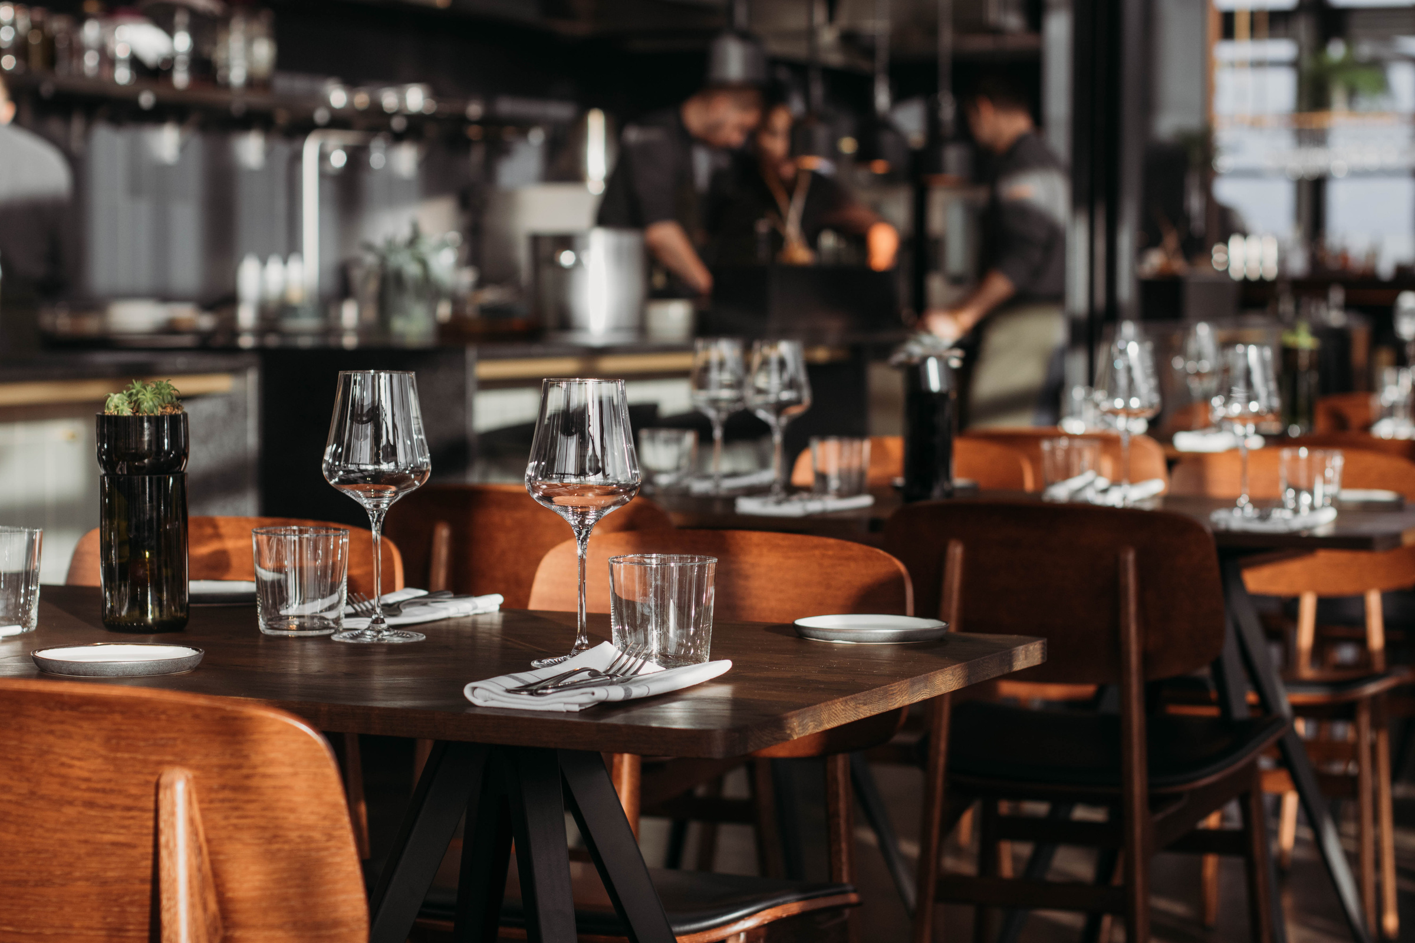


Mission Statement
At our restaurant, we strive to provide an exceptional dining experience by offering delicious and flavorful hot pot dishes made with the finest ingredients. We aim to create a warm and inviting atmosphere where customers can gather, celebrate, and enjoy the art of communal dining.
Special offers on holidays
Keys to Success
Offering a wide selection of fresh and premium ingredients to cater to various dietary preferences and tastes.
Providing excellent customer service with well-trained staff who are knowledgeable about the menu and attentive to customer needs.
Maintaining a clean and comfortable dining environment to ensure a pleasant experience for our guests.
Implementing effective marketing strategies to attract new customers and retain existing ones.
BOOKING
Cozy Atmosphere
Delicious Food

Slide 6

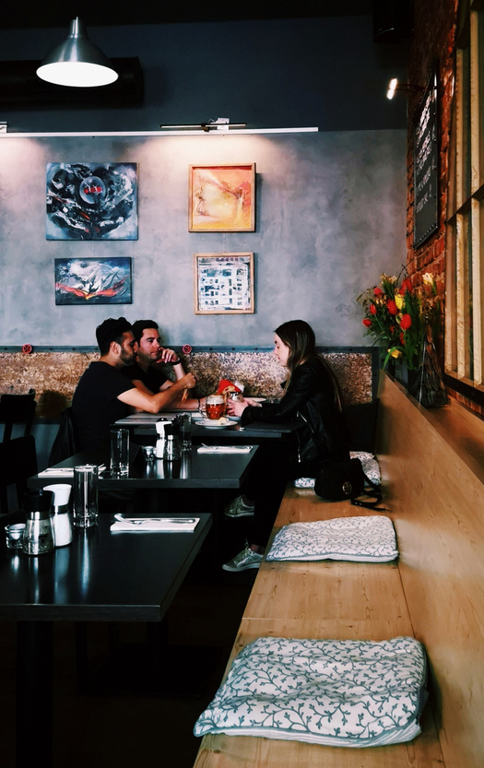

II.DESBCRIPTION OF BUSSINESS
BIG BITE Restaurant, a unique and authentic Vietnamese culinary experience that stands out in the competitive restaurant landscape. Our business is dedicated to bringing the rich and diverse flavors of Vietnam to our customers in a warm and inviting atmosphere.

Slide 7
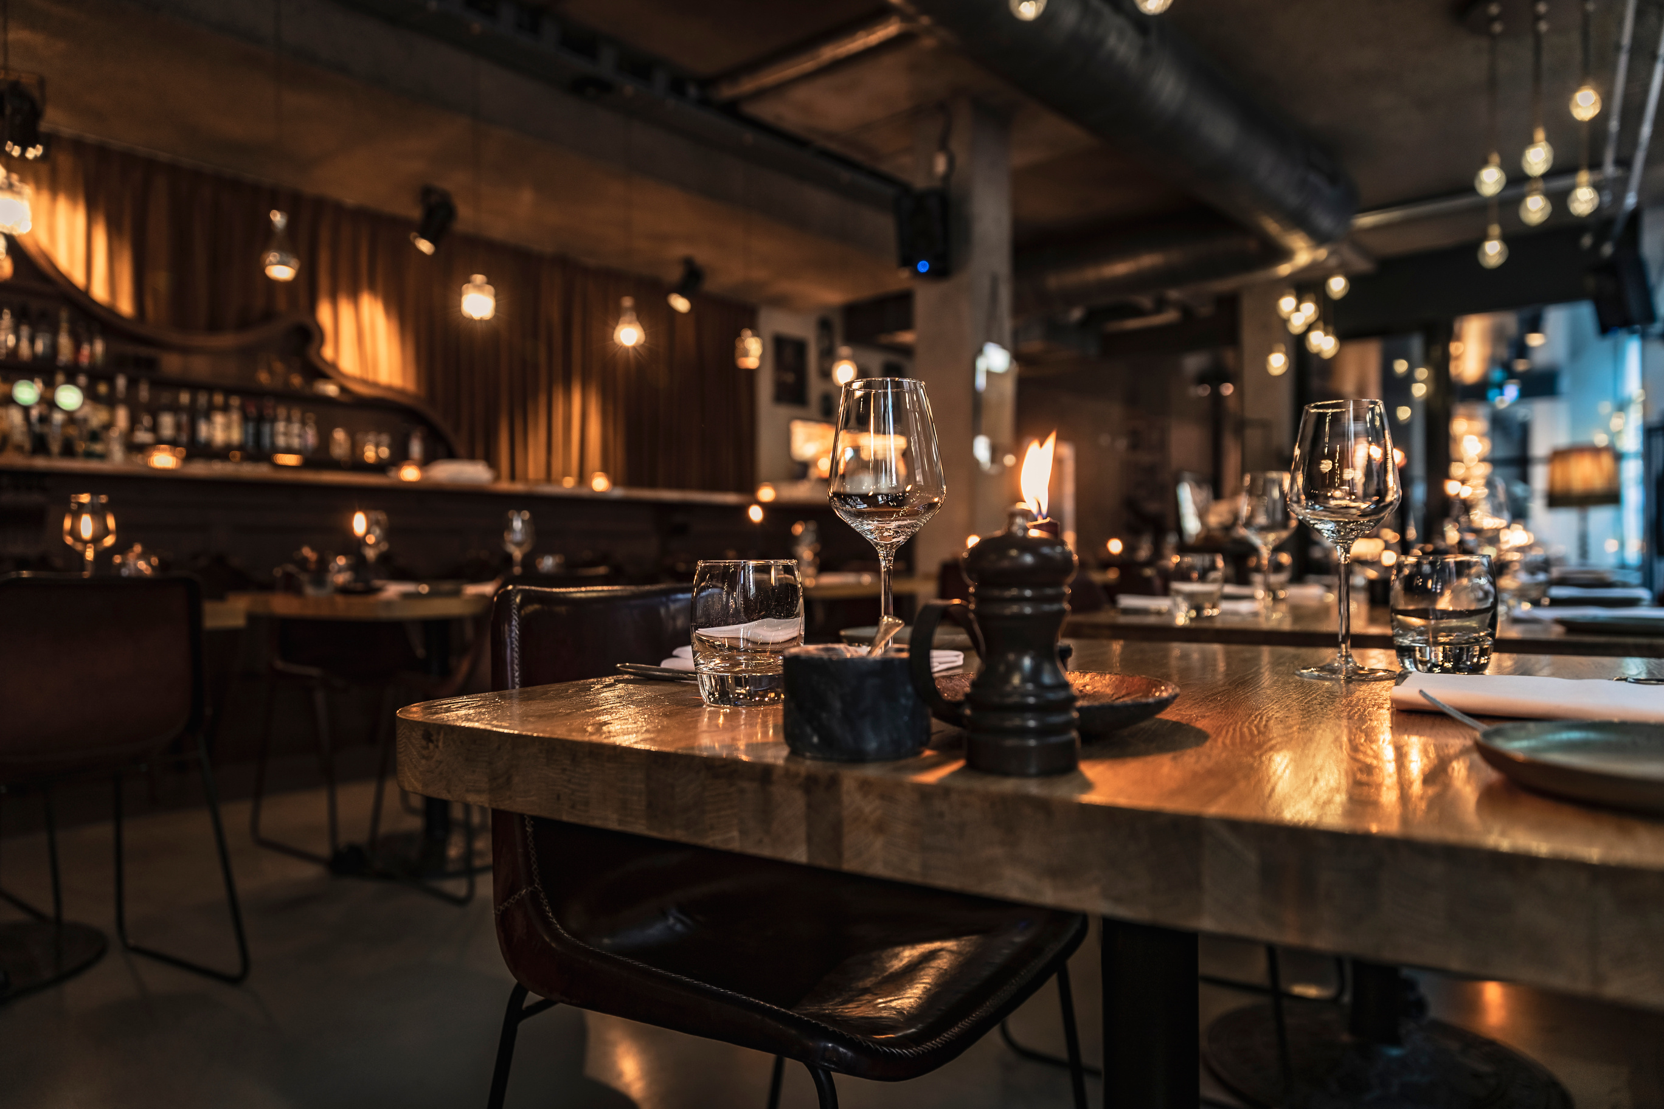

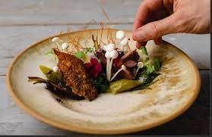
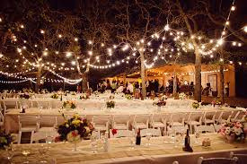

Key Features
Authenticity
Culinary Innovation
Warm Ambiance
Community Engagement

Slide 8
Company Ownership/Legal Entity
Legal Structure
Business Type
Licenses and Permits
Our restaurant is presented as a new, independent business organized as a privately held corporation
BIG BITE restaurant falls under the category of a service-oriented business, specifically in the restaurant and hospitality industry
Food Service License, Alcohol License, Business Operating License, Zoning Permits, Process for Acquiring Licenses and Permits.

Slide 9
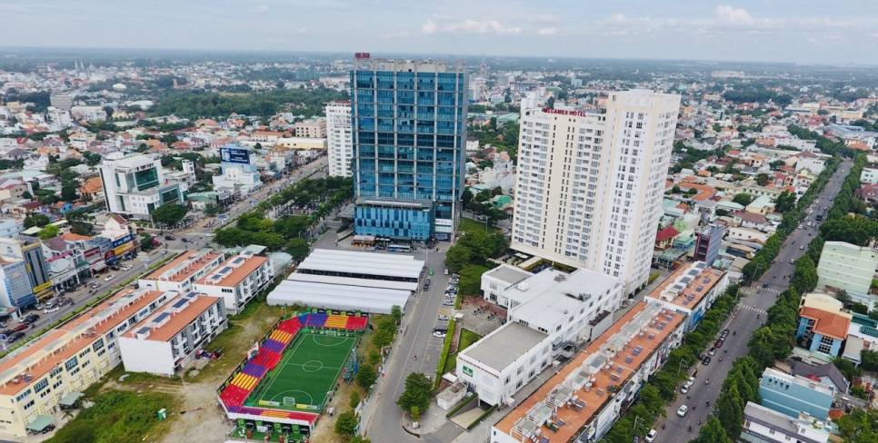
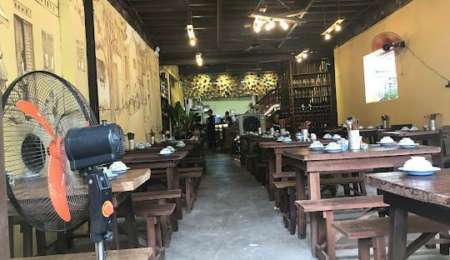

Location
Our restaurant is strategically located in Chanh Nghia, with high foot traffic and easy accessibility. The location offers ample parking facilities and is in close proximity to other popular dining and entertainment venues, attracting a diverse customer base.

Slide 10
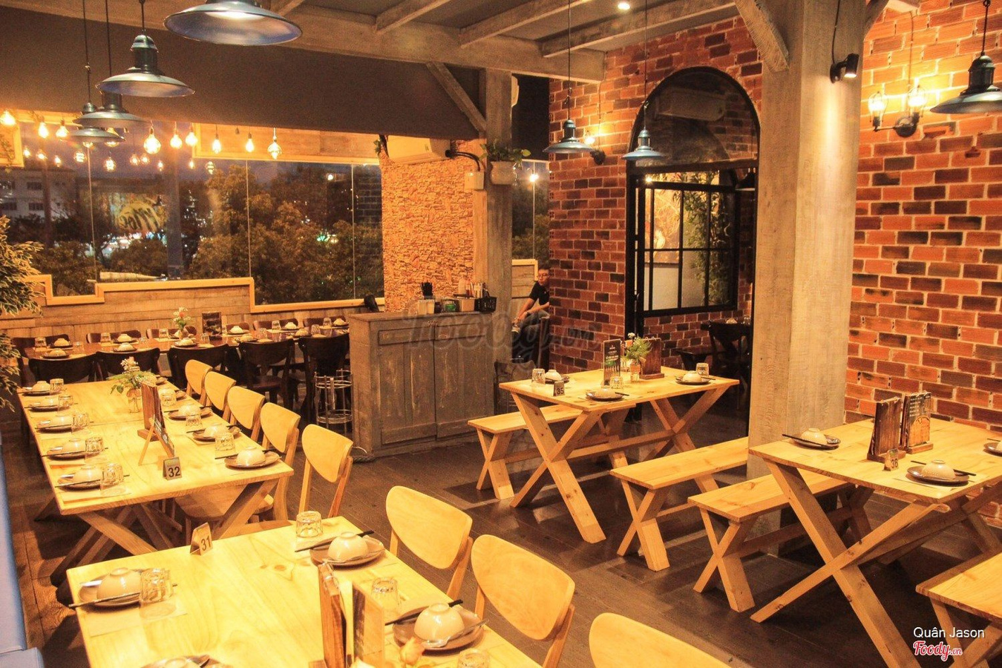

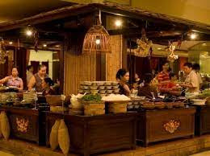
Interior
The interior of our restaurant has been thoughtfully designed to create a welcoming and comfortable atmosphere. The layout promotes a sense of community and encourages social interaction. We have carefully planned the seating arrangements to accommodate both small and large groups, ensuring a pleasant dining experience for all our guests

Slide 11



Hours of Operation
We operate six days a week, providing breakfast and dinner services to cater to different customer preferences and schedules
Monday - Saturday
5:00 a.m - 9:00 a.m
5:00 p.m - 11:00 p.m

Slide 12



Products and Services
Our restaurant offers breakfast dishes and serves hot pot for dinner
Breakfast: We provide delicious and diverse breakfast options such as banh mi, pho, noodles and beverages like coffee, fruit juice, and smoothies.
Dinner Hot Pot: We offer a late-night hot pot service, allowing customers to savor fresh and diverse hot pot dishes.

Slide 13



Suppliers
We have established a strong partnership with Truong Thinh Food Distribution Company Limited, a reputable supplier known for providing high-quality food products. Truong Thinh Company is known for their commitment to sourcing fresh and premium ingredients, ensuring that our restaurant receives the best quality supplies for our dishes.

Slide 14
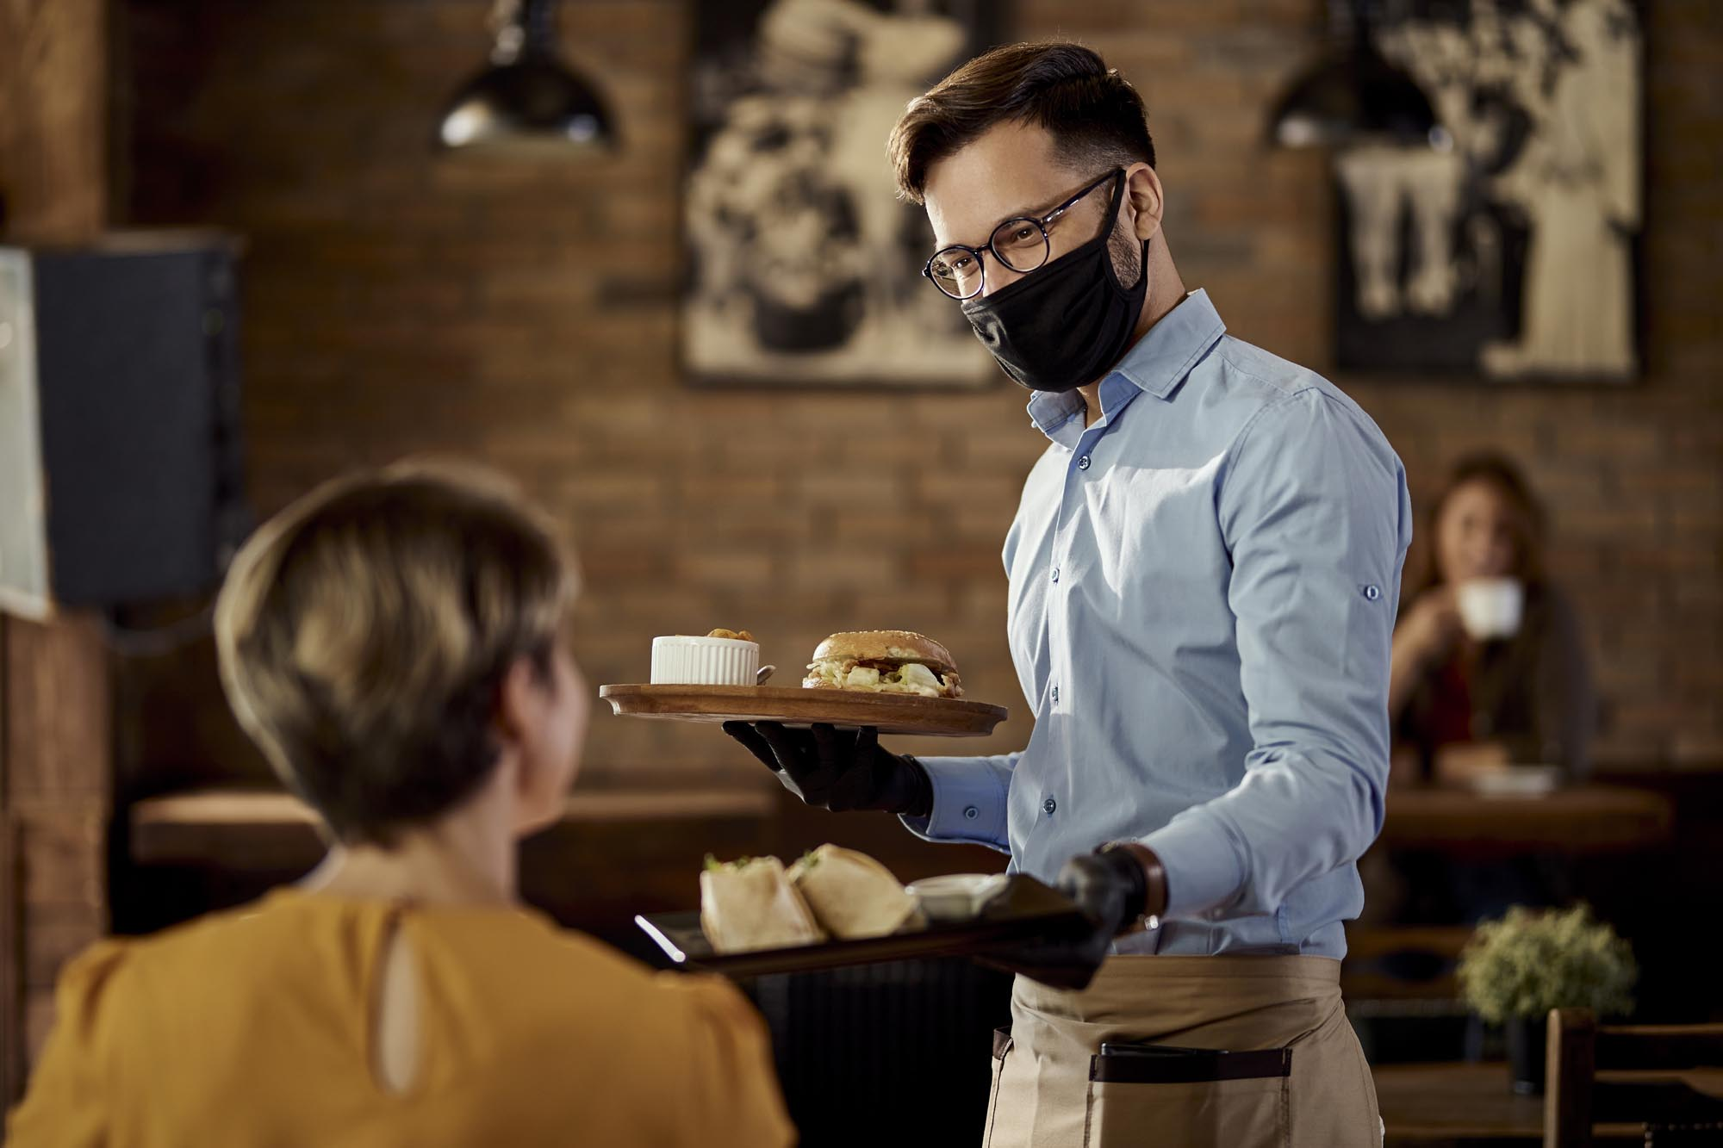
Service
Our well-trained staff are committed to delivering exceptional service to our customers. They are knowledgeable about the menu, attentive to customer needs, and provide recommendations based on individual preferences. We prioritize customer satisfaction and strive to exceed expectations at every interaction.

Slide 15

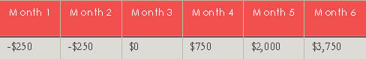
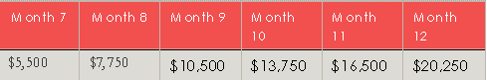
Financial Management
We have conducted a thorough financial analysis and have developed a comprehensive start-up and operating budget. The start-up costs include equipment purchases, renovations, licenses/permits, and marketing expenses. Our operating budget covers ongoing expenses such as rent, utilities, payroll, supplies, and marketing.

Slide 16
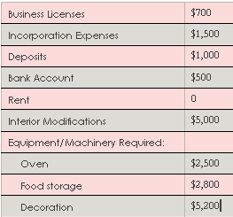
Start-Up/Acquisition Summary
The start-up costs for our restaurant include equipment purchases, leasehold improvements, licenses/permits, initial inventory, marketing expenses, and personnel costs. A detailed breakdown of these costs can be found in the Appendix. We have secured adequate funding through a combination of personal investment and a small business loan.

Slide 17
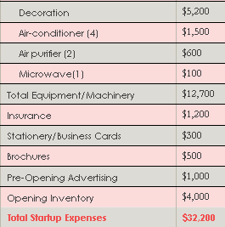
Start-Up/Acquisition Summary
The start-up costs for our restaurant include equipment purchases, leasehold improvements, licenses/permits, initial inventory, marketing expenses, and personnel costs. A detailed breakdown of these costs can be found in the Appendix. We have secured adequate funding through a combination of personal investment and a small business loan.

Slide 18
III.MARKETING
Understanding your potential customers and effectively marketing your business are crucial for success. Knowing their demographics, preferences, and expectations helps tailor campaigns and deliver the right message. By meeting expectations and addressing pain points, you build trust and loyalty. Market research and ongoing communication with customers provide valuable insights for improvement. Overall, customer knowledge and effective marketing drive growth and long-term success.

Slide 19
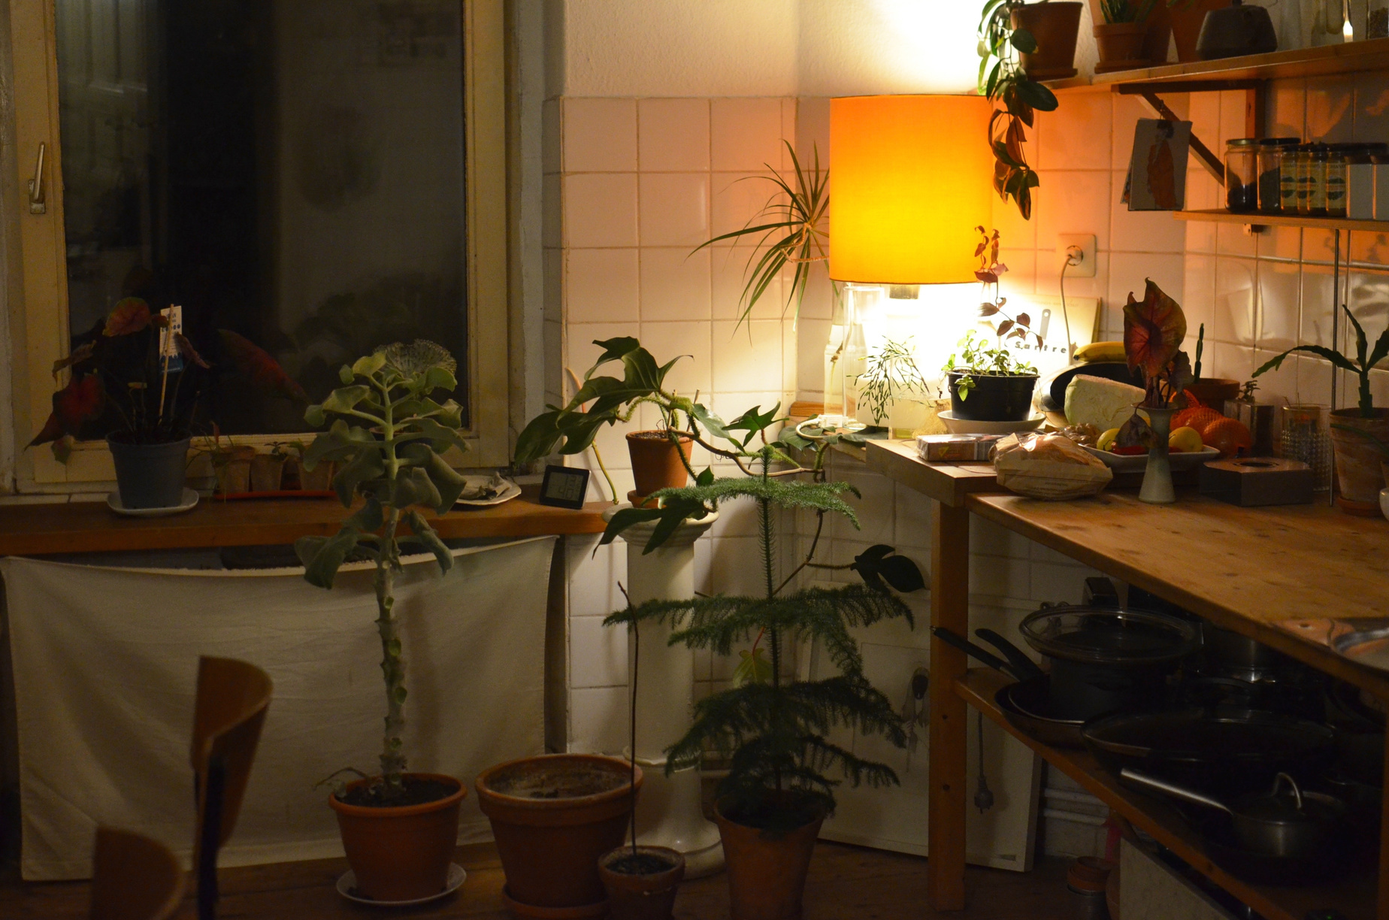
Market Analysis
Our target market consists of individuals who appreciate high-quality hot pot dining experiences. The demographics include a wide range of age groups, with a focus on urban residents who enjoy dining out. The potential customer base is substantial, given the popularity of hot pot cuisine in our region. To reach our target market, we will employ a combination of digital marketing, local advertising, and word-of-mouth recommendations.

Slide 20
Market Segmentation
Within the hot pot market, there are various segments based on factors such as price, quality, and product range. Our primary business falls into the mid-to-high-end segment, offering a premium dining experience at a competitive price point. We estimate that our business will initially capture a significant portion of this segment, and we aim to expand our market share through consistent customer satisfaction and positive brand reputation.

Slide 21
Competition
In our area, there are several competitors offering hot pot dining experiences. We have identified their strengths and weaknesses by studying their operations, pricing strategies, and marketing approaches. By leveraging our unique offerings, such as a diverse ingredient selection and exceptional service, we aim to differentiate ourselves and provide a superior experience to our customers. We will monitor the market closely and adapt to changing trends and technologies to stay ahead.

Slide 22
Pricing
Our pricing policy is based on a competitive position that offers value for money. We have analyzed industry averages and our competitors' pricing policies to ensure we remain in line with market expectations. Regular monitoring of prices and overhead costs will ensure our business operates profitably. We will stay informed about market changes and innovations to adjust our pricing strategy accordingly.

Slide 23
Advertising and Promotion
To promote our business, we will utilize a mix of advertising and promotion channels. These include social media marketing, online directory services, local media (newspaper, radio), and strategic partnerships with complementary businesses. We will determine our advertising budget based on a comprehensive analysis of target audience reach and cost-effectiveness. Tracking the results of our marketing efforts will help us optimize our strategies and maximize return on investment.

Slide 24
Strategy and Implementation
To promote our business, we will utilize a mix of advertising and promotion channels. These include social media marketing, online directory services, local media (newspaper, radio), and strategic partnerships with complementary businesses. We will determine our advertising budget based on a comprehensive analysis of target audience reach and cost-effectiveness. Tracking the results of our marketing efforts will help us optimize our strategies and maximize return on investment

Slide 25
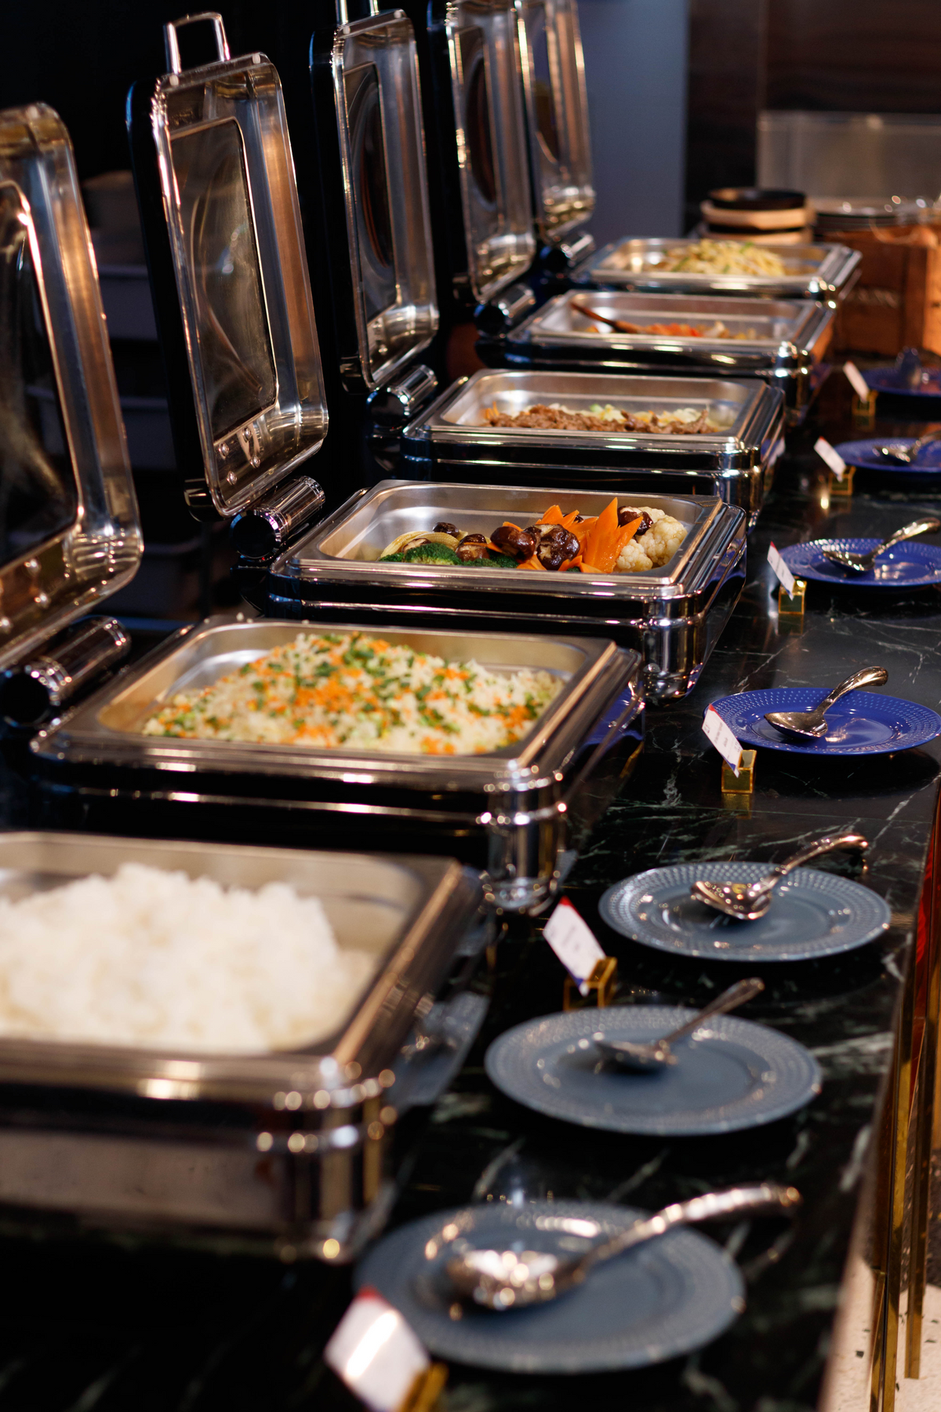
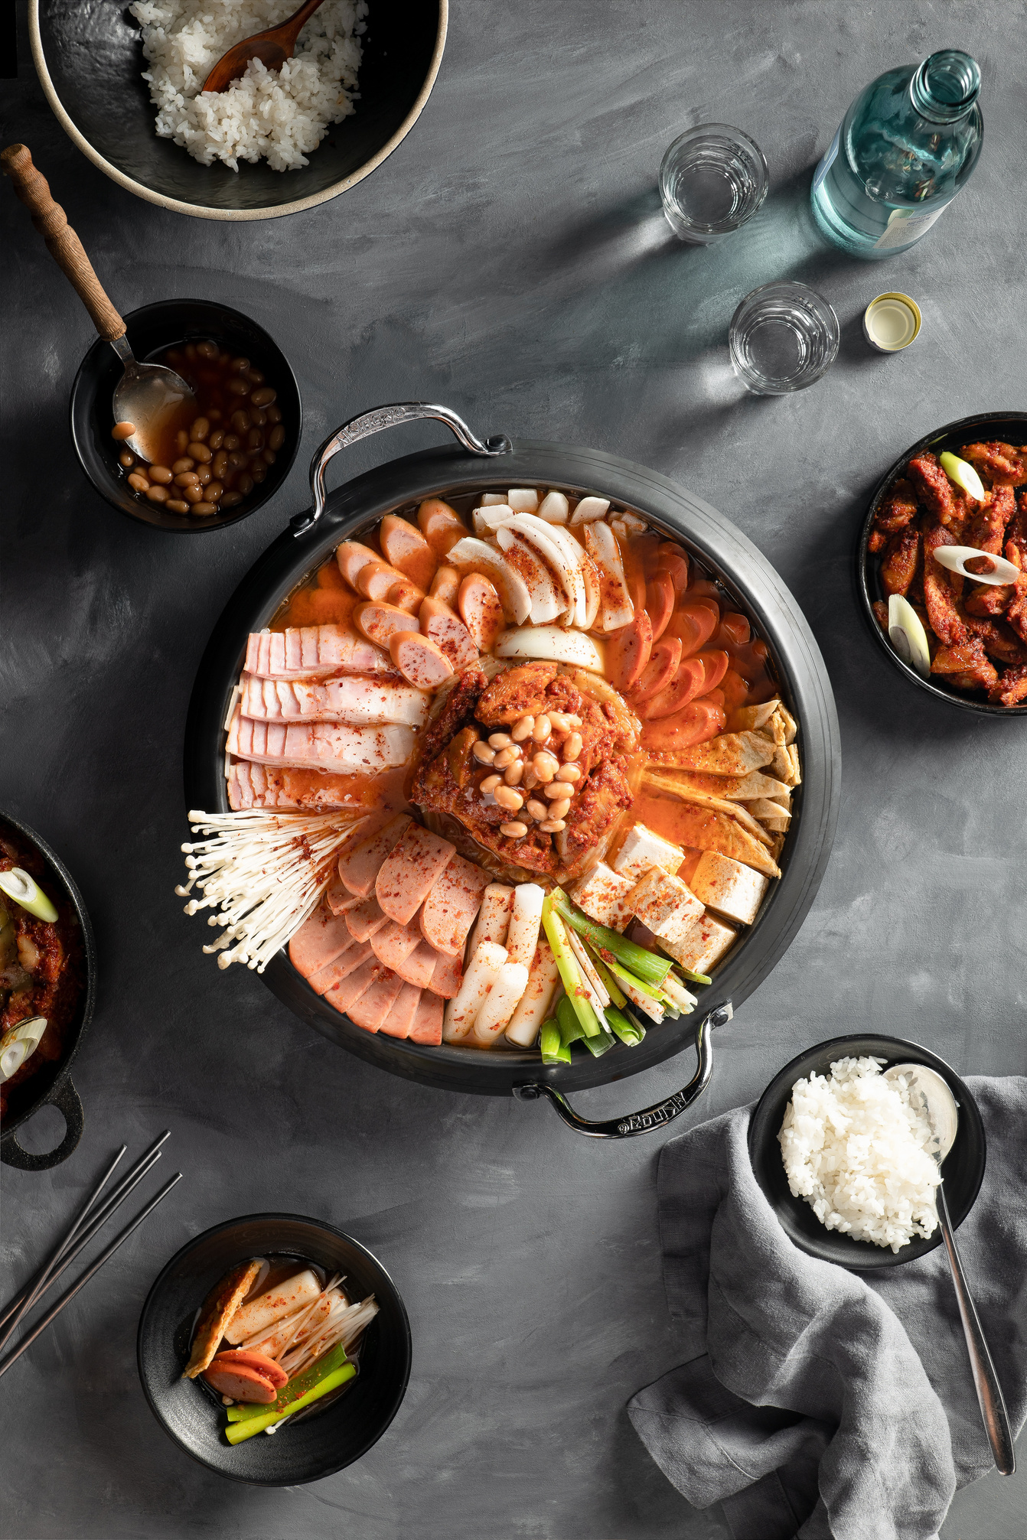
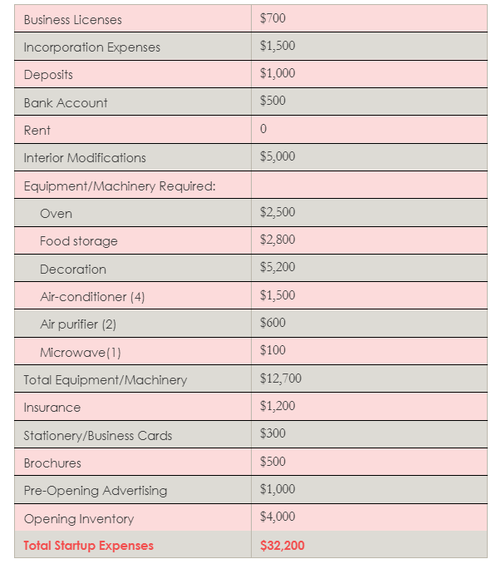
IV.Appendix
Start-Up Expenses

Slide 26
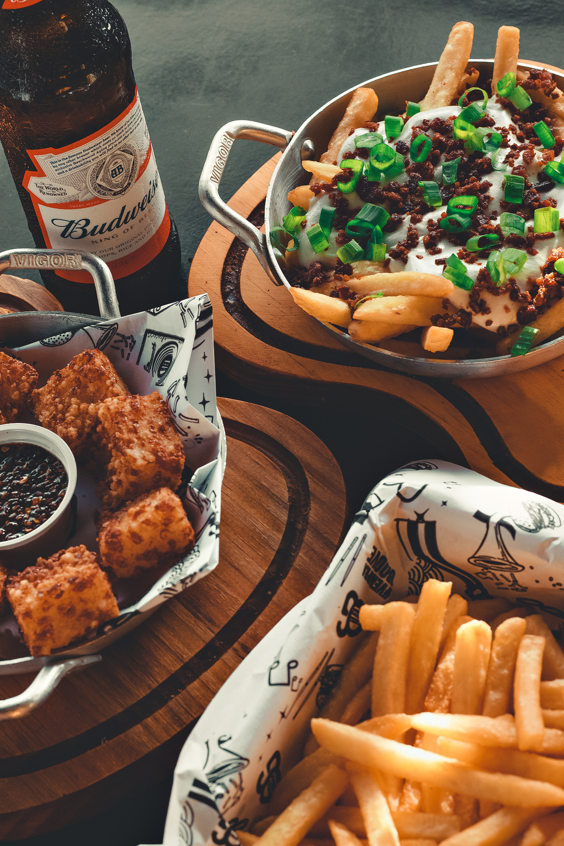
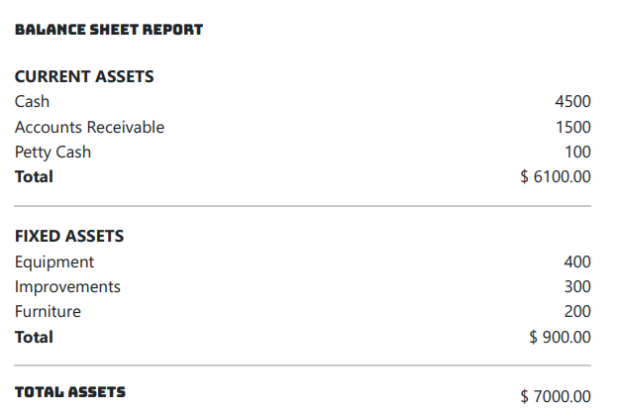
IV.Appendix

Slide 27
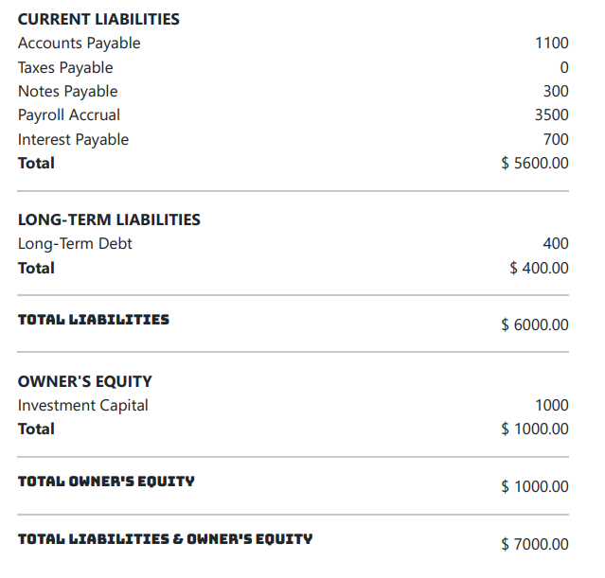
IV.Appendix

Slide 28

THANK YOU
- BIG BITE RESTAURANT -

Slide 29
